Slide 1
Connectionist Computing
COMP 30230/41390
Gianluca Pollastri
office: CASL, ground floor Science East.
email: gianluca.pollastri@ucd.ie
Connectionist Computing COMP 30230

Slide 2



Credits
Geoffrey Hinton, University of Toronto.
  borrowed some of his slides for “Neural Networks” and “Computation in Neural Networks” courses.
Ronan Reilly, NUI Maynooth.
  slides from his CS4018.
Paolo Frasconi, University of Florence.
  slides from tutorial on Machine Learning for structured domains.
Connectionist Computing COMP 30230

Slide 3
Lecture notes on Moodle
https://csmoodle.ucd.ie/moodle/course/view.php?id=288
Strictly confidential...
Enrolment key: 30230cc
Connectionist Computing COMP 30230

Slide 4
Books
No book covers large fractions of this course.
Parts of chapters 4, 6, (7), 13 of Tom Mitchell’s “Machine Learning”
Parts of chapter V of Mackay’s “Information Theory, Inference, and Learning Algorithms”, available online at:
http://www.inference.phy.cam.ac.uk/mackay/itprnn/book.html
Chapter 20 of Russell and Norvig’s “Artificial Intelligence: A Modern Approach”, also available at:
http://aima.cs.berkeley.edu/newchap20.pdf
More materials later..
Connectionist Computing COMP 30230

Slide 5
Marking
3 landmark papers to read, and submit a 10-line summary on Moodle about: each worth 6.67%
a small connectionist tool to build and play with: 30%
Final exam: 50%
Connectionist Computing COMP 30230

Slide 6
Connectionism
A computational approach to modelling the brain which relies on the interconnection of many simple units to produce complex behavior
Not the usual paradigm where there is a powerful central processor that executes serially a static program:
  simple elements,
  parallel processing,
  learning..
Connectionist Computing COMP 30230

Slide 7
Connectionism, AI and Deep Learning
Connectionism starts from Cognitive Science and the study of the brain.
Between the mid 80s and circa 2005 it produced the vast majority of what we now call Deep Learning.
While between 2006 and now Deep Learning has come up with new algorithms, much of what differentiates it from Connectionism is about emphasis and packaging rather than genuinely new science.
Connectionist Computing COMP 30230

Slide 8
Facts about the brain
The brain consists of around 10¹¹ neurons.
Neurons are connected: each neuron receives between 10³ and 10⁴ connections. Hence there are 10¹⁴ to 10¹⁵ connections in the brain (100-1000 Tbytes to store 1 number for each of them).
The "currency" of the brain is the action potential or voltage spike.
There appears to be considerable localisation of function in the brain.
Connectionist Computing COMP 30230

Slide 9
A typical cortical neuron
Gross physical structure:
  One axon that branches
  A dendritic tree that collects input from other neurons
Axons typically contact dendritic trees at synapses
  A spike of activity in the axon causes charge to be injected into the post-synaptic neuron
Spike generation:
  Outgoing spikes whenever enough charge has flowed in at synapses to depolarise the cell membrane
axon
body
dendritic
tree
Connectionist Computing COMP 30230

Slide 10
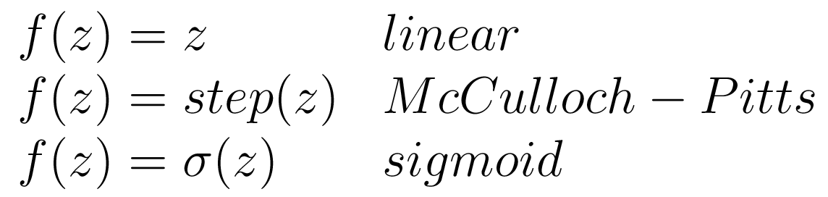
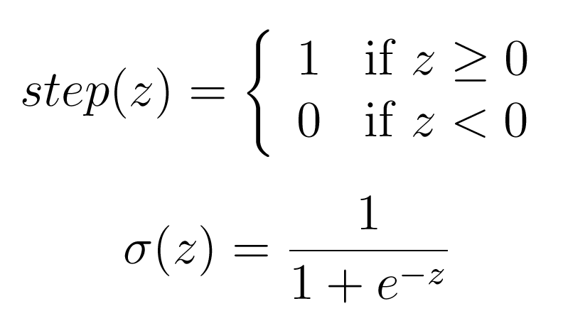
Output activation functions
Connectionist Computing COMP 30230

Slide 11
Learning
We have a few simple models of neurons
Their behaviour depends on the value of their synaptic weights (free parameters).
How do we learn/adjust parameters?
Connectionist Computing COMP 30230

Slide 12
A bit of history first
McCulloch & Pitt's formal neuron (1943)
Hebb's learning rule (1949)
Rosenblatt's Perceptron (1957)
Associators: Anderson (1972), Kohonen (1972)
Hopfield's network (1982)
Hinton, Sejnowski, & Ackley's Boltzmann learning algorithm (1984)
Rumelhart, Hinton & Williams error backpropagation learning algorithm (1986)
research
activity
"old" connectionism
"new" connectionism
Connectionist Computing COMP 30230

Slide 13
Hebbian learning
"When an axon of cell A is near enough to excite cell B and repeatedly or persistently takes part in firing it, some growth process or metabolic changes takes place in one or both cells such that A's efficiency as one of the cells firing B, is increased ." (Hebb, 1949)
Connectionist Computing COMP 30230

Slide 14
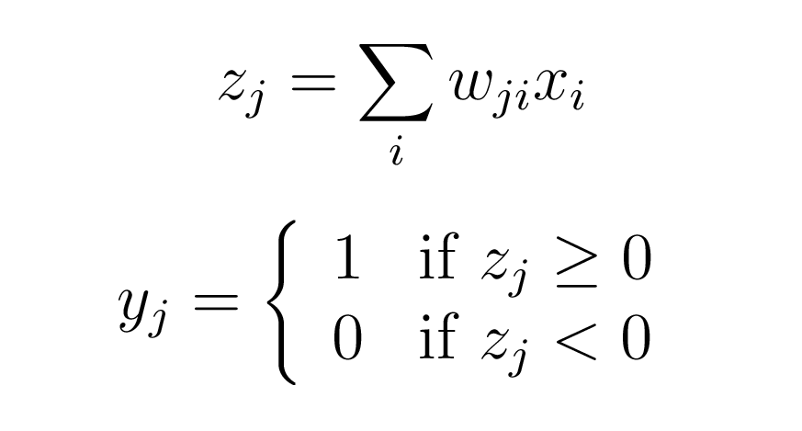
Rosenblatt’s perceptron (’57)
A binary neuron, inputs possibly real-valued:
This is really just a McCulloch-Pitts neuron.. but Rosenblatt actually implemented it on a computer..
Connectionist Computing COMP 30230
Notes:
draw it

Slide 15
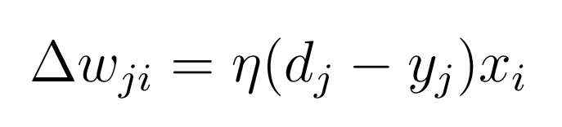
Rosenblatt’s perceptron
.. and introduced the idea of training in practice by applying something close to the Hebbian learning rule:
learning rate
desired output – actual output
(supervision!)
input
learning (weight change)
Connectionist Computing COMP 30230
Notes:
draw it

Slide 16
Rosenblatt’s perceptron
This rule assumes that we have examples
Notice that, since this is a binary neuron, (d-y) can only be: -1, 0, 1
learning rate
desired output – actual output
(supervision!)
input
learning (weight change)
Connectionist Computing COMP 30230
Notes:
draw it

Slide 17
Rosenblatt’s contributions
McCulloch-Pitts neuron (’43) and Hebbian learning (’49) implemented in practice.
Computer simulations to study the behaviour of perceptrons
Mathematical analysis of their properties
Rosenblatt was probably the first who talked of “connectionism”.
He studied also perceptrons with multiple layers (see next slide..)
He called “error backpropagation” a procedure to extend the Hebbian idea to multiple layers.
Connectionist Computing COMP 30230

Slide 18
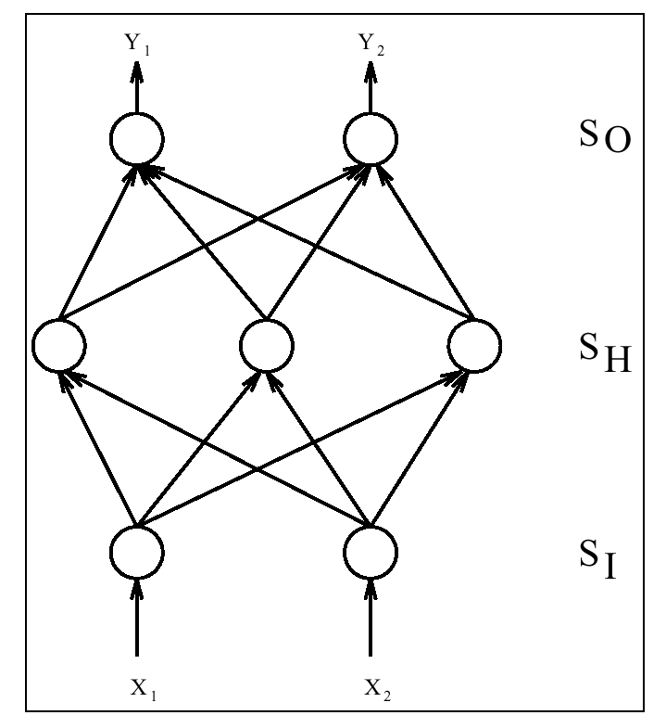
Connectionist Computing COMP 30230

Slide 19
Rosenblatt's contributions: the dark side
Expectations were raised that the perceptron would be the endgame of AI.
When it became clear that wouldn't happen, research in the field went into the wilderness for over a decade.
There is a history of boom and bust in the field. Wait 'til we discover that Deep Learning can't do general purpose AI.
Connectionist Computing COMP 30230

Slide 20
Minsky-Papert ‘69
McCulloch & Pitt's formal neuron (1943)
Hebb's learning rule (1949)
Rosenblatt's Perceptron (1957)
Associators: Anderson (1972), Kohonen (1972)
Hopfield's network (1982)
Hinton, Sejnowski, & Ackley's Boltzmann learning algorithm (1984)
Rumelhart, Hinton & Williams error backpropagation learning algorithm (1986)
research
activity
"old" connectionism
"new" connectionism
Connectionist Computing COMP 30230

Slide 21
Minsky and Papert’s analysis
Studied simple, one-layered perceptrons
Proved mathematically that some tasks just cannot be performed by such perceptrons:
  whether there is an odd or an even number of inputs firing it
  XOR
(incidentally, these results apply only to the simplest kind of perceptron)
Connectionist Computing COMP 30230

Slide 22
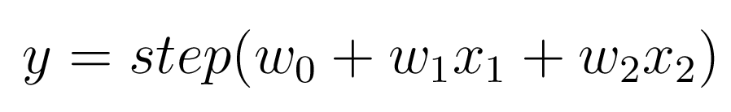
Minsky & Papert: XOR
Output is binary-thresholded linear combination of inputs:
The perceptron draws a line in the output space.
x₂
w₂
w₁
x₁
1
w₀
(This is how we draw neurons)
Connectionist Computing COMP 30230

Slide 23
Minsky & Papert: XOR (2)
x₂
x₁ | x₂ | f(x)
0 | 0 | 0
0 | 1 | 1
1 | 0 | 1
1 | 1 | 0
-
+
+
x₂
w₂=?
-
x₁
w₁=?
x₁
No linear separation
surface exists!!
1
w₀= ?
Connectionist Computing COMP 30230

Slide 24
The aftermath
After the 1969 critique by Minsky and Papert many AI researchers (and funding agencies) perceived connectionism as fruitless.
(this is a little bizarre since their proofs applied only to a very basic kind of perceptron)
Only during the 80s was there a renaissance of connectionism:
  "other" (rule-based) AI was perceived as stagnant
  computers were finally getting a lot faster/cheaper
  mathematicians and statisticians took connectionism over from cognitive scientists:
    new developments (to be continued)
  (at this point even Minsky partially retracted..)
Connectionist Computing COMP 30230

Slide 25
Associators (70s)
Linear associators
  Simple generalisation of the Perceptron to networks with more than one output.
  Networks with n inputs and m outputs. Nothing hidden, only 1 layer: direct connections (synapses) between any input and any output.
  As in the perceptron case, any output is a combination of all the inputs.
  Linear output function (was binary-threshold in the perceptron).
Connectionist Computing COMP 30230

Slide 26
Associators
output
input
A grid is the traditional
way of representing
associators
input
output
Connectionist Computing COMP 30230

Slide 27
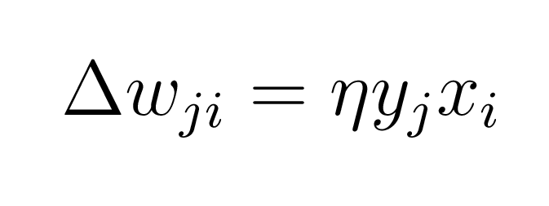
Learning in associators
Learning involves a variation of Hebb’s rule:
yj : j-th output
xi : i-th input
Connectionist Computing COMP 30230

Slide 28
Learning in associators
Under certain conditions learning in LAs can be "one-shot". After showing a set of patterns once, LAs memorise them exactly. The conditions for this to happen relate to the degree of interdependence among the input vectors.
Orthogonality: This is the strongest form of independence. Two vectors are said to be orthogonal if their dot-product is 0.
Linear independence: A set of vectors is linearly independent if no members of the set is a linear combination of the other set members.
Linear dependence: If at least one vector in set can be written as a linear combination of the others, the set of vectors is said to be linearly dependent.
Connectionist Computing COMP 30230

Slide 29
v1
orthogonal
v1
non-orthogonal
but linearly independent
v2
v2
v3
v2
v1
v1
v2
linearly dependent:
v2 = c v1
linearly dependent:
v3 = v1+v2
Connectionist Computing COMP 30230

Slide 30
Learning from a set of examples
We have a set of examples (input-desired output couples).
For each couple compute the weight updates associated with it according to Hebb’s rule, add them to the weights.
Hopefully at the end of a learning cycle over all the examples the associator will output the correct values for each possible input.
Connectionist Computing COMP 30230

Slide 31
Learning in associators
Learning involves a variation of Hebb’s rule:
yj : j-th output
xi : i-th input
Connectionist Computing COMP 30230

Slide 32
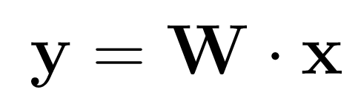
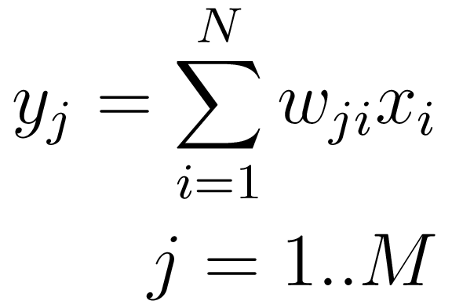
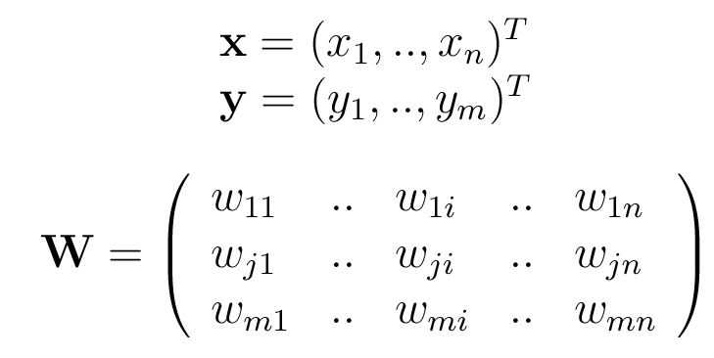
some notation
The network
Can rewrite as:
If we define:
Connectionist Computing COMP 30230

Slide 33
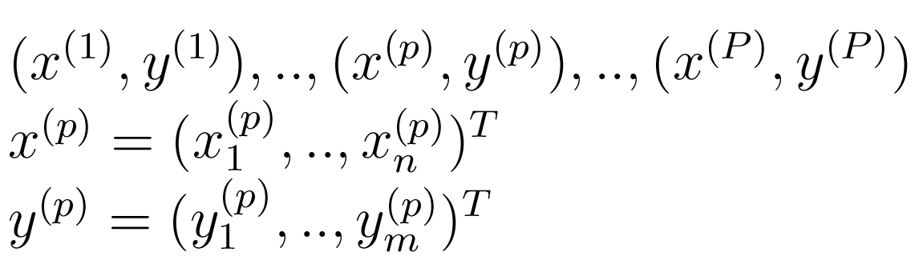
some notation
Set of examples that we want to learn from:
x = inputs, y=outputs
Connectionist Computing COMP 30230

Slide 34
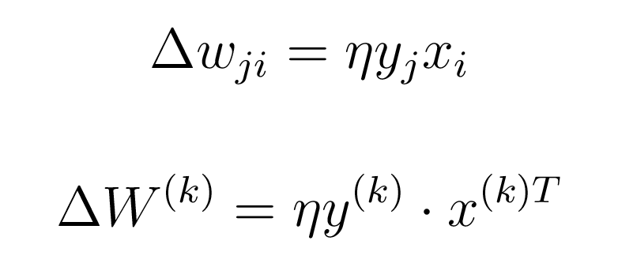
Weight update
Here is the Hebbian learning rule. We can rewrite it for the k-th input-output example using vectors:
Connectionist Computing COMP 30230

Slide 35
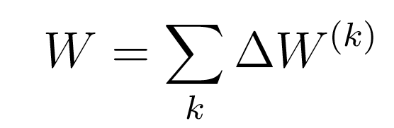
Weight matrix
At the end of a training cycle the overall weight matrix of the associator will be the sum of the updates for each example:
Connectionist Computing COMP 30230

